Slide 1
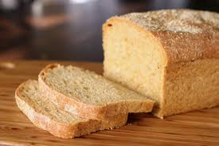
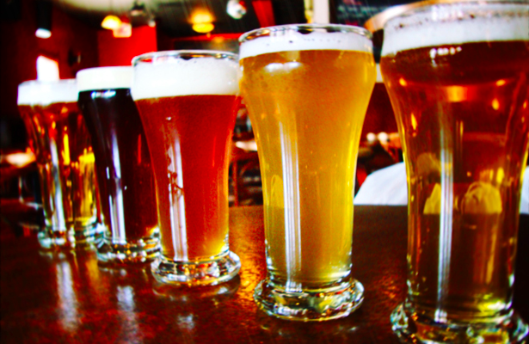
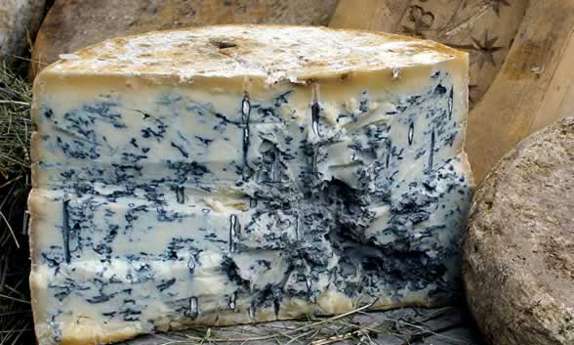
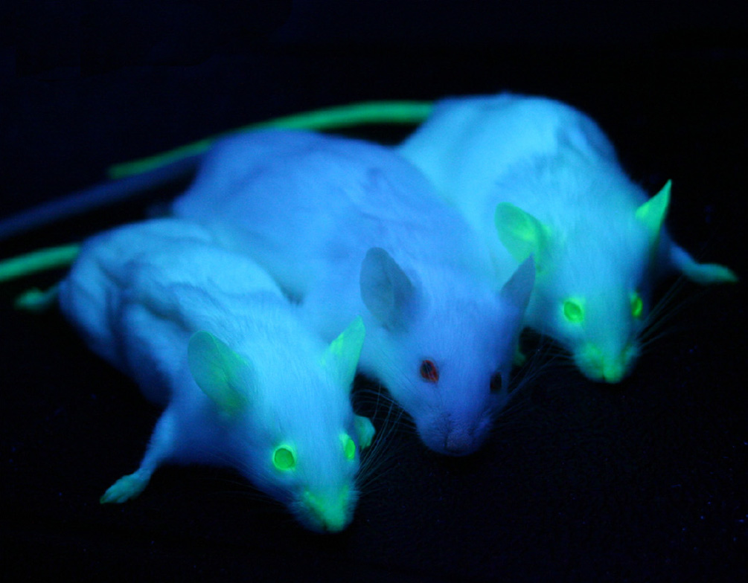
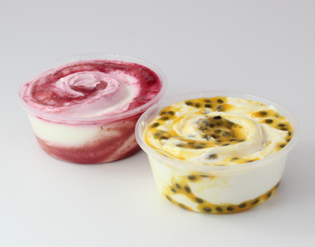
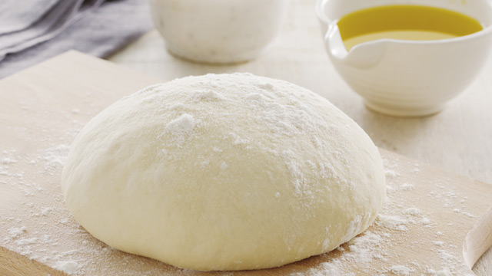
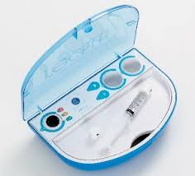
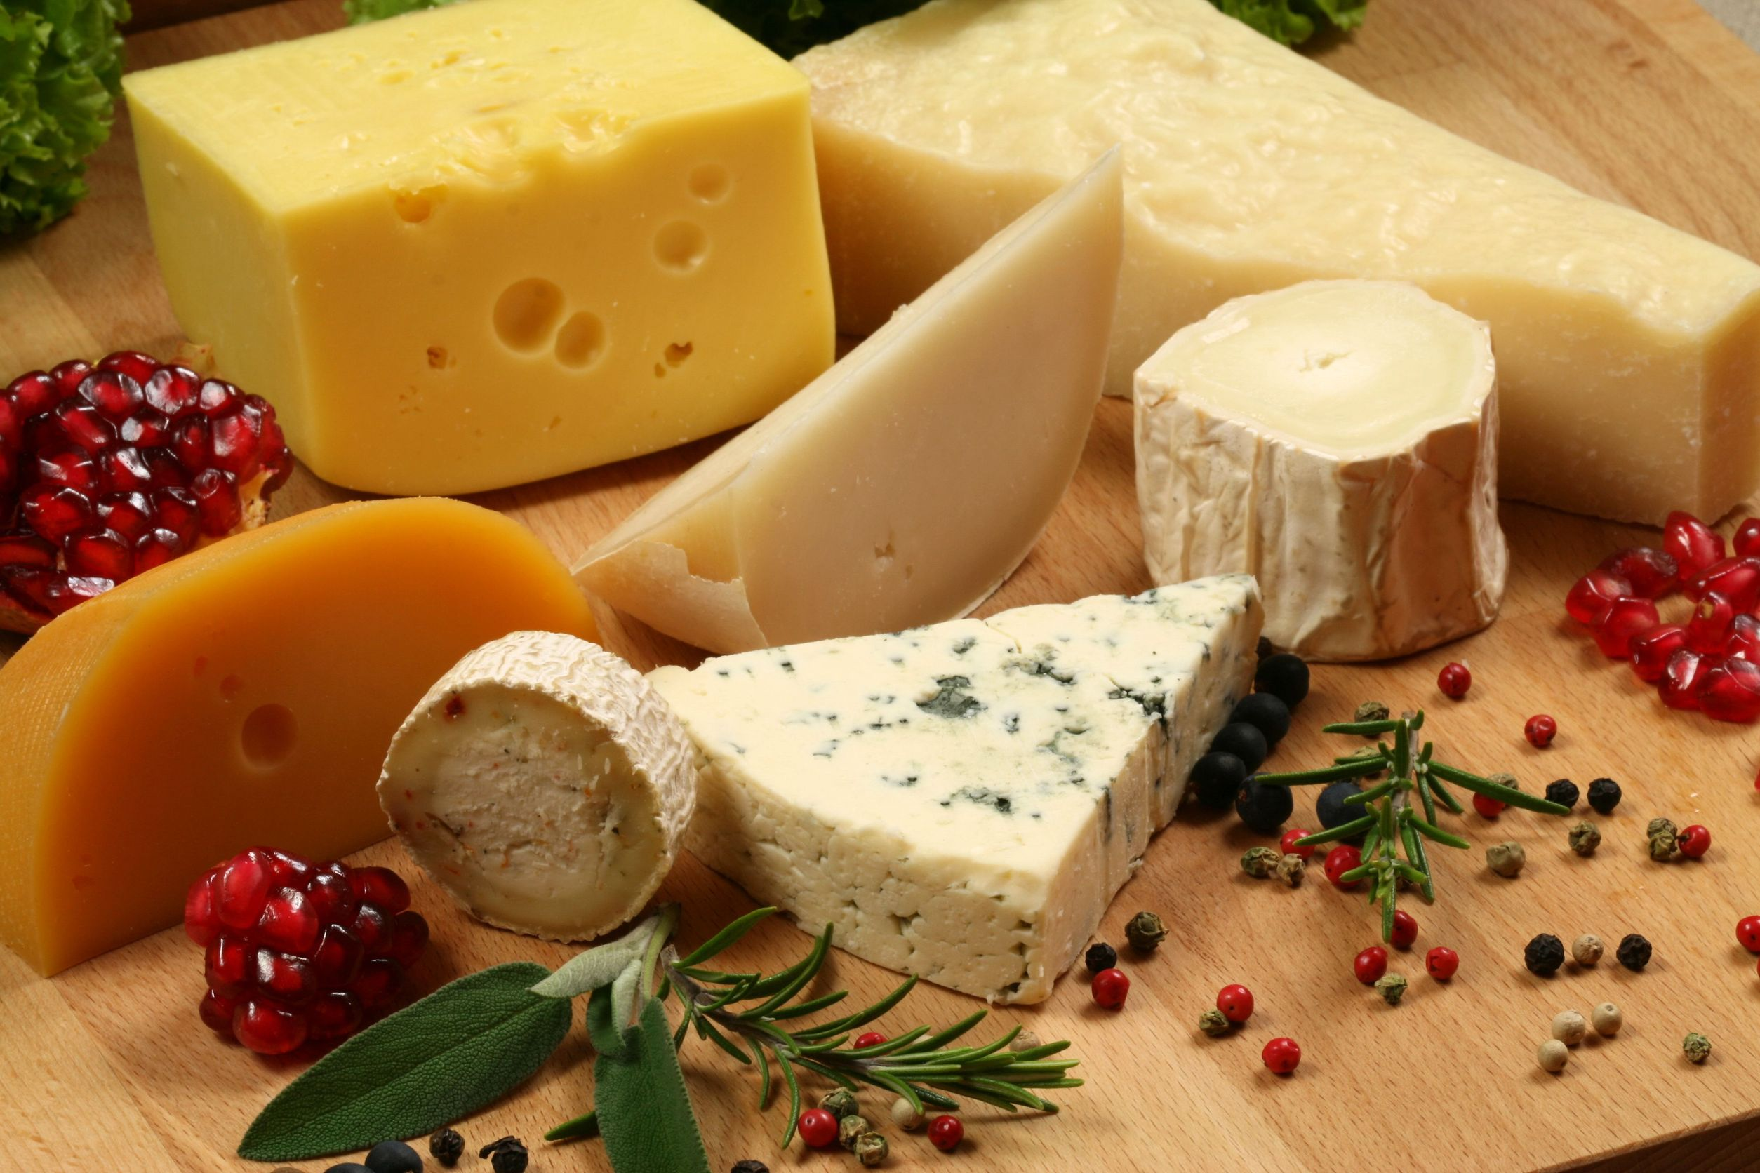


Slide 2
Biotechnology
The exploitation and manipulation of cellular processes for industrial production of products used by humans

Slide 3
Human Genome Project
1990 – 2003 (ongoing analysis of data)
Aim map the location of genes on all 46 chromosomes
Genome complete set of genetic information of an organism
4000 genetic disorders have been discovered

Slide 4
Human Genome Project
Given rise to new technology and access to more information
Gene replacement
Monitor gene expression in cancers
Mapping out pathways in cancer development
Better genetic testing – screening for disease risk
Health prevention

Slide 5
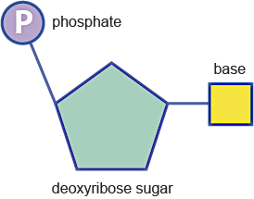
Structure of DNA
Nucleotide
Deoxyribose [5-C sugar]
Phosphate group
Nitrogenous base
DNA molecule
Made up of thousands of nucleotides

Slide 6
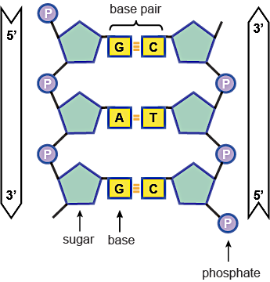
Structure of DNA
DNA molecule
Two chains of alternating sugars and phosphates are linked by nitrogenous bases (weak H-bonds)
Cytosine – Guanine
Adenine – Thymine

Slide 7
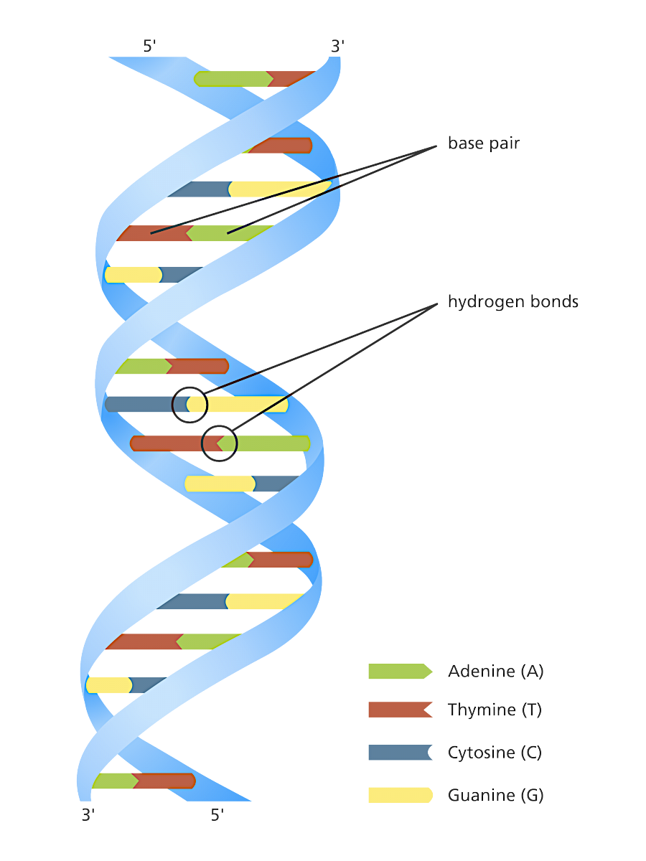
Structure of DNA
Two chains of alternating sugars and phosphates joined by the base pairs, are twisted into a spiral shape known as a
double helix

Slide 8
DNA sequencing
Determining the precise order of nucleotides in a sample of DNA
Allows for comparison of DNA sequences
Detects point mutations, small insertions and deletions
Can show whether a person will develop an inherited disease

Slide 9
Hereditary spastic paraplegia
Progressive limb weakness and stiffness, often resulting in paralysis
Symptoms being during mid-20s – mid 50s
No cure
Treatment: physical therapy (prevention)
Researchers studied and located mutations present in affected individuals but not in affective relatives

Slide 10
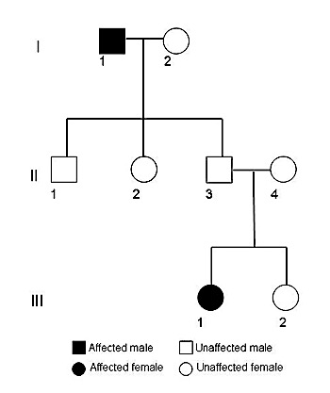
Hereditary spastic paraplegia
Researchers studied two families whose members had HSP
Able to locate mutations present in affected individuals but not in affective relatives
This discovery has allowed for genetic screening in individuals with a risk of developing the disease

Slide 11
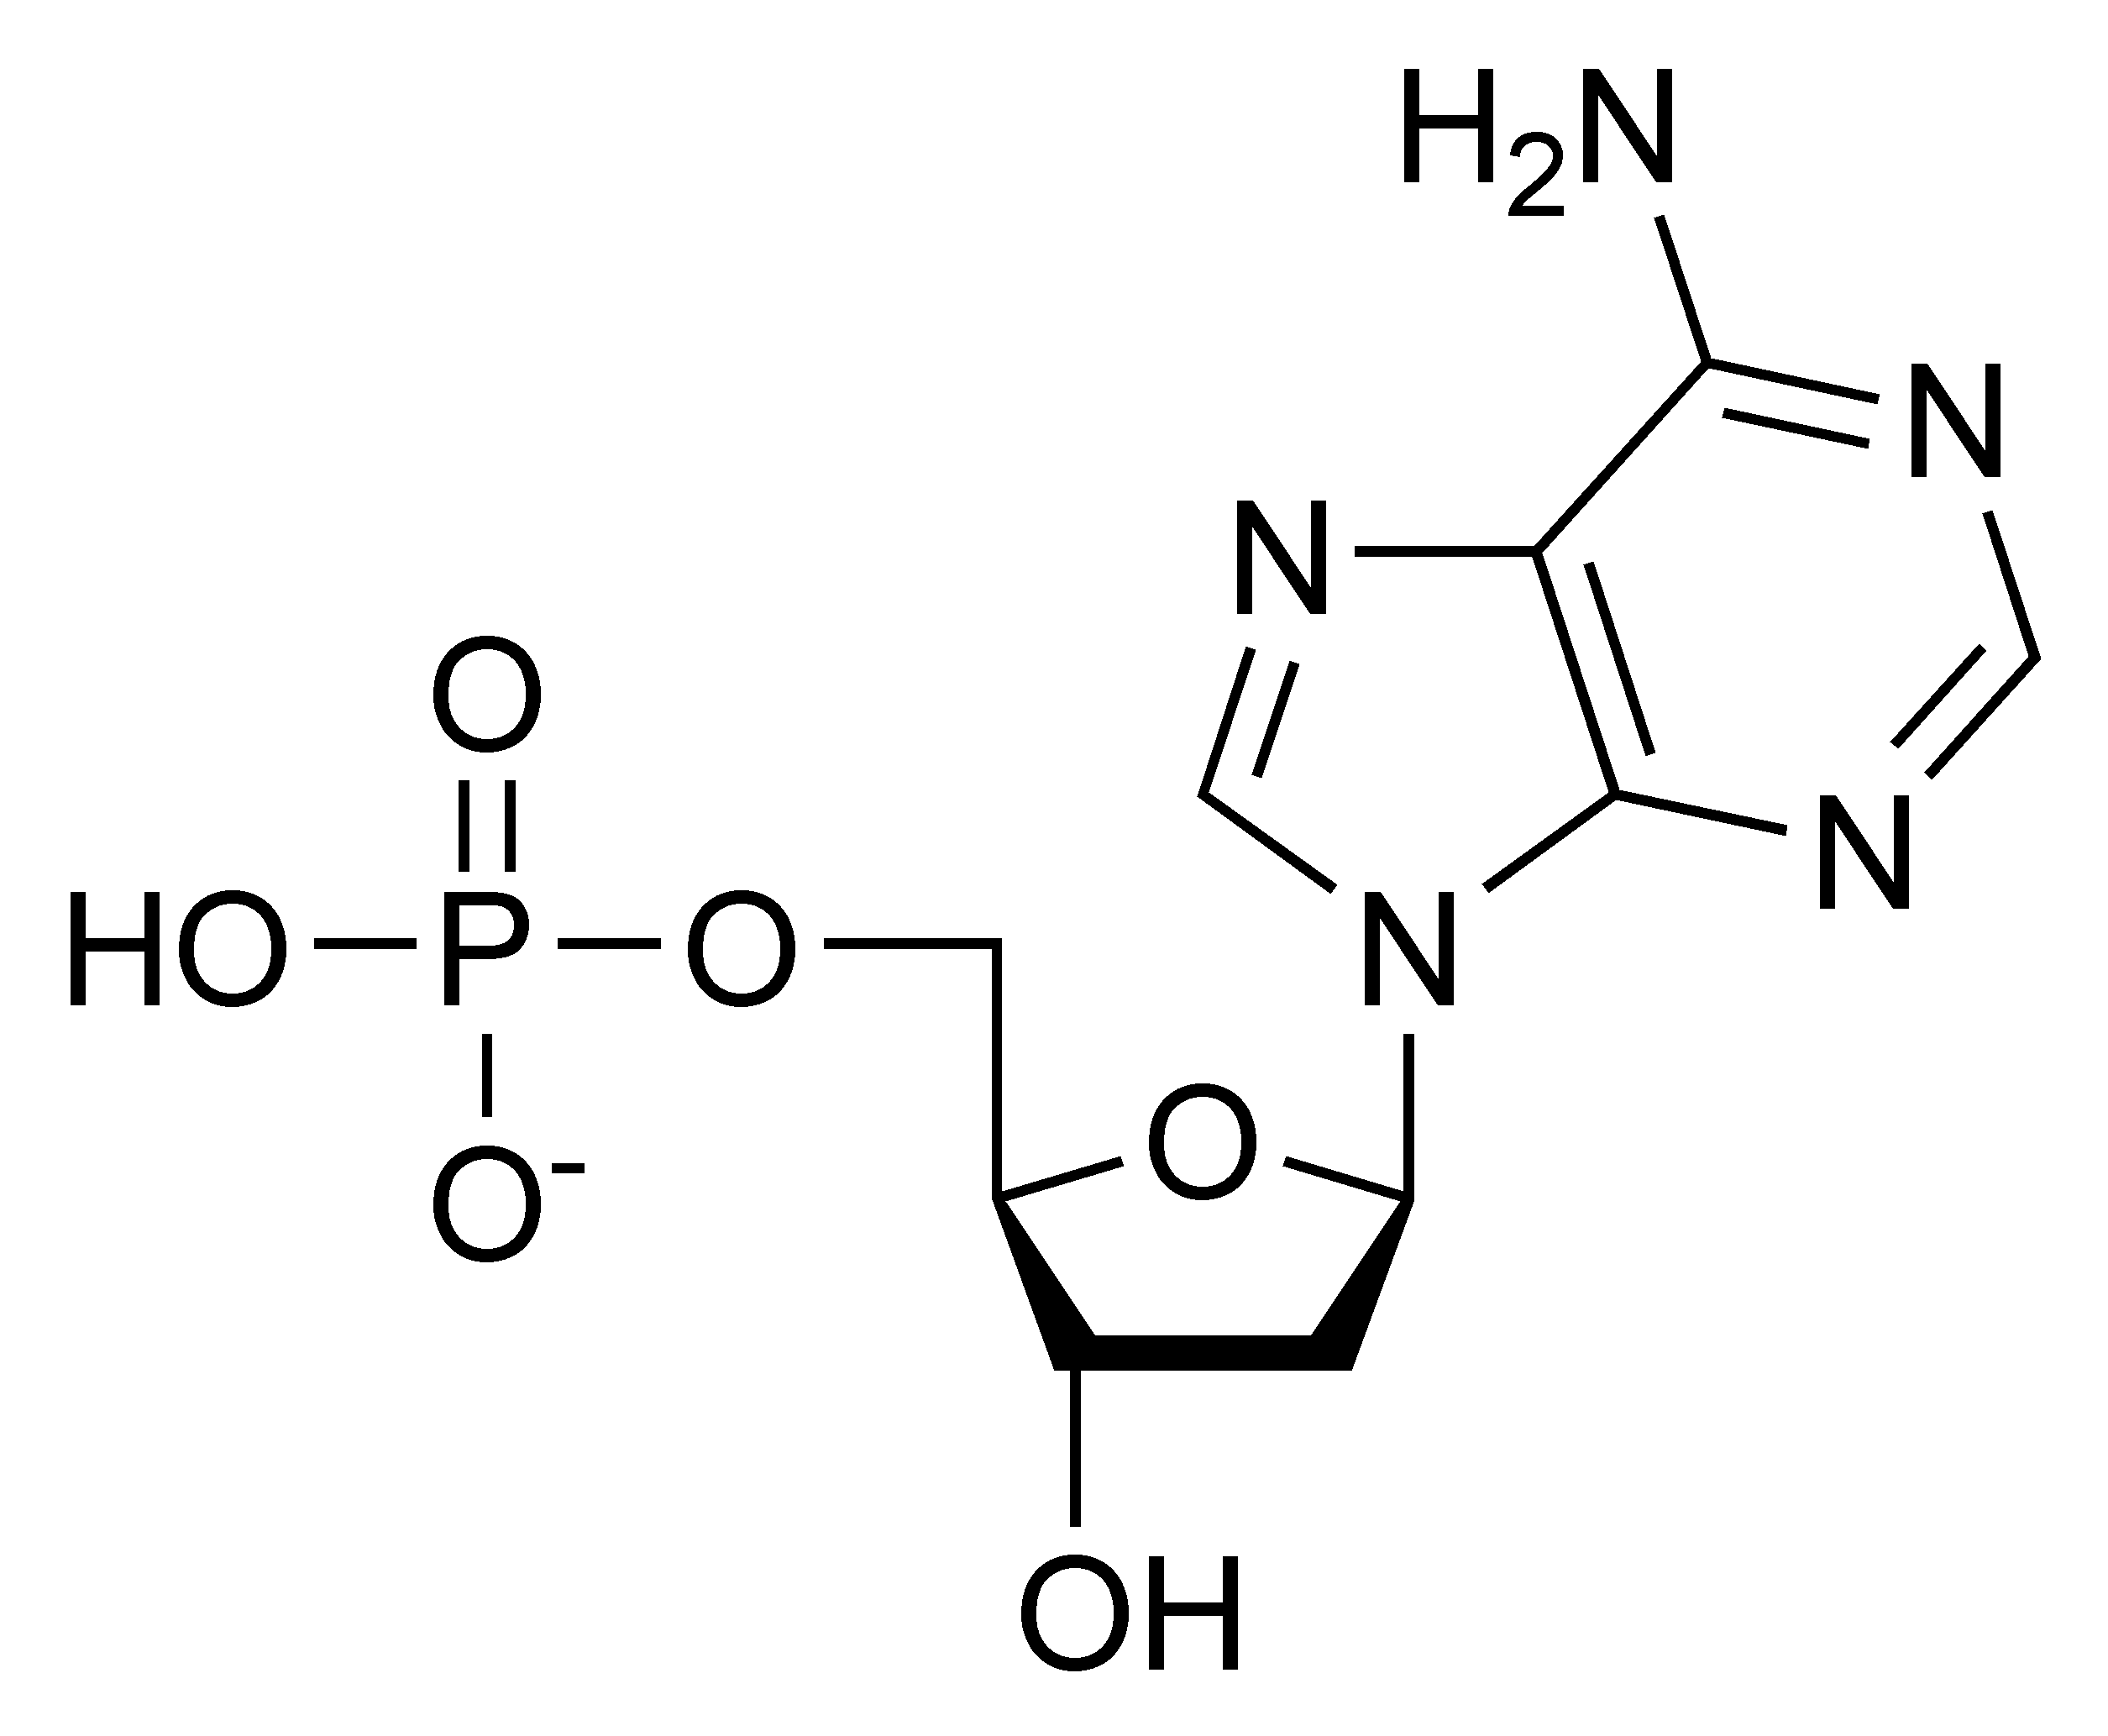
DNA Sequencing

Slide 12
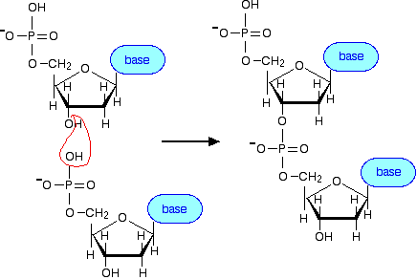
DNA Sequencing
Each new nucleotide is bonded to the hydroxyl group (OH) of the previous nucleotide

Slide 13
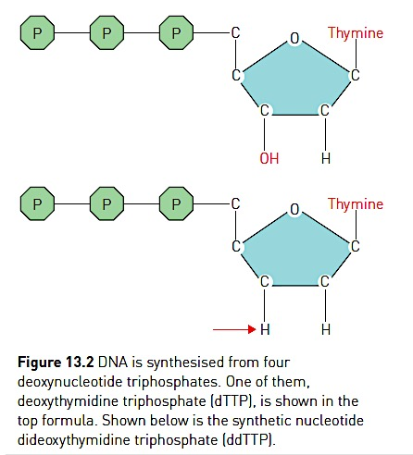
Sanger Sequencing

Slide 14


Slide 15
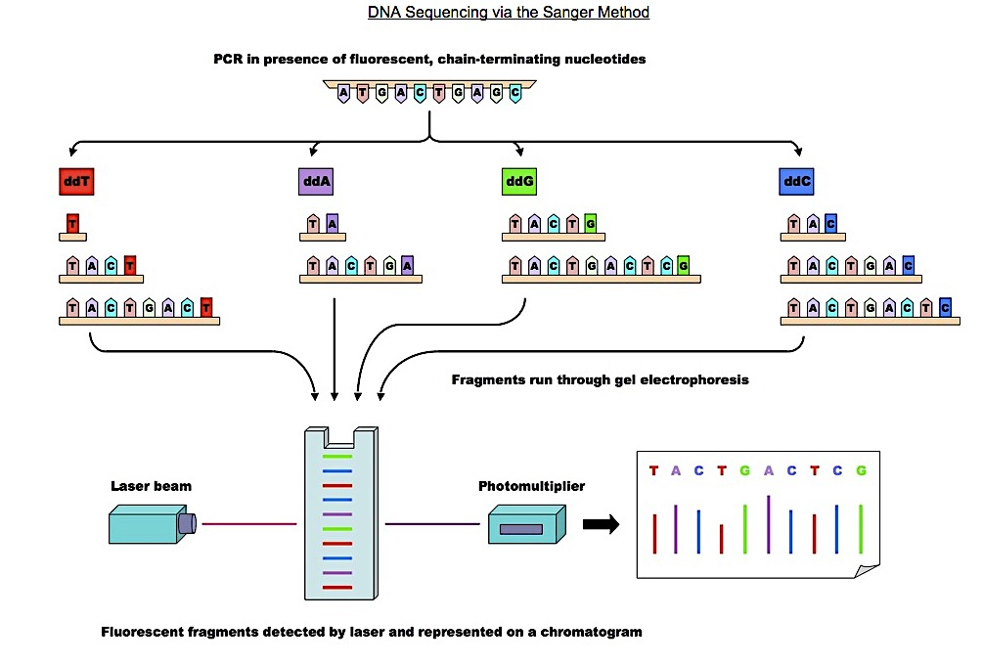
Sanger Sequencing

Slide 16
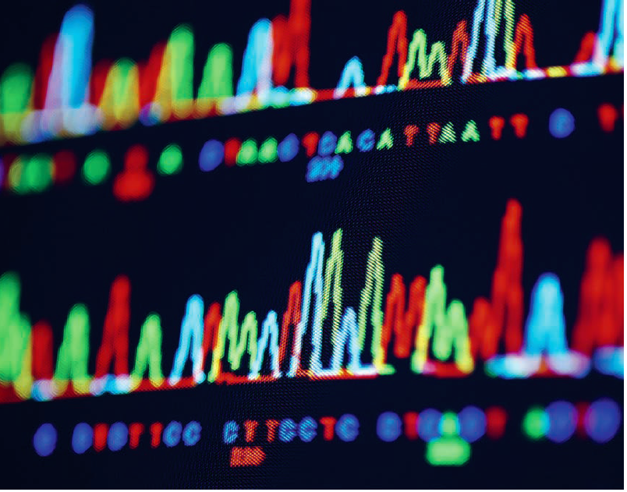

Slide 17
Sanger Sequencing
DIDEOXYNUCLEOTIDES
Synthetic nucleotides that lack the hydroxyl group (-OH) are added to the sequencing reaction
Preventing chain elongation
Allowing for comparison of DNA molecules, and determination of sequences

Slide 18
Lesson objectives
Appreciate the importance of the Human Genome Project
Describe in detail the structure of DNA
Understand the concept of Sanger sequencing

